Slide 1
Grid Research Internship Opportunities at BNL
Meng Yue
Renewables and Grid Modernization Group
Interdisciplinary Science Department

Slide 2
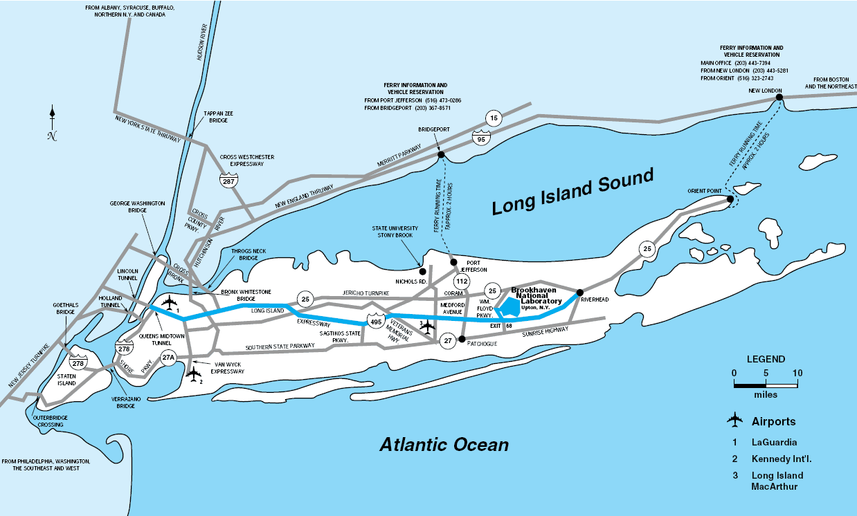
About Brookhaven National Laboratory
Brookhaven Lab is the only multidisciplinary national laboratory in the northeastern United States and one of New York State’s largest centers of scientific research.
Approximately 60 miles east of New York City, the research at BNL includes nuclear and high energy physics, energy science and technology, environmental and bioscience, nanoscience, and national security.
Notes:
Impact assessments of high penetration of renewables
Data analytics and machine learning in cybersecurity for energy forecasting and damage forecasting under severe weather conditions.
Probabilistic contingency analysis, uncertainties modeling and parameterization and quantification, optimization for transmission and generation planning, ESS sizing, siting, and operation.

Slide 3
Expertise of Renewables and Grid Modernization Group
Supports the development of solutions to key issues facing the deployment, grid integration, and operation of renewable energy technologies.
Cross-domain expertise:
Large-scale system modeling and simulation for dynamics, stability, and optimization
Statistical analysis and modeling and probabilistic risk assessment
Big data, AI/ML, and quantum computing technologies
Cybersecurity
Climate/weather/energy modeling
Strategic collaborations with local utilities, universities, and other national labs
Notes:
Impact assessments of high penetration of renewables
Data analytics and machine learning in cybersecurity for energy forecasting and damage forecasting under severe weather conditions.
Probabilistic contingency analysis, uncertainties modeling and parameterization and quantification, optimization for transmission and generation planning, ESS sizing, siting, and operation.

Slide 4
Internship Opportunities at Renewables and Grid Modernization Group
Hosts summer students every year:
Opportunities include algorithm development and implementation for power grid planning, operation, optimization and control, under high penetration levels of renewables by applying mathematical modeling and AI/ML
Working closely with experts in climate/weather sciences, computational scientists, and mathematicians across BNL
Notes:
Impact assessments of high penetration of renewables
Data analytics and machine learning in cybersecurity for energy forecasting and damage forecasting under severe weather conditions.
Probabilistic contingency analysis, uncertainties modeling and parameterization and quantification, optimization for transmission and generation planning, ESS sizing, siting, and operation.

Slide 5
For more information about AGM projects at BNL
https://www.bnl.gov/isd/agm/index.php
For more information about the Renewables and Grid Modernization Group:
https://www.bnl.gov/isd/renewables.php
Contact:
Meng Yue
Renewables and Grid Modernization Group
Brookhaven National Laboratory
Upton, NY 11973-5000
Email: yuemeng@bnl.gov
Phone: (631) 344-7140

